Slide 1
Theory of Learning and Choice

Slide 2
Today’s goals – constructing real models
Two modeling approaches
Empirical – data driven
Axiomatic – logic driven
Two psychological processes
Learning
Choice
A framework for modeling decision making
Bandit Models
Broader relevance of models
Machine learning & Neural networks

Slide 3
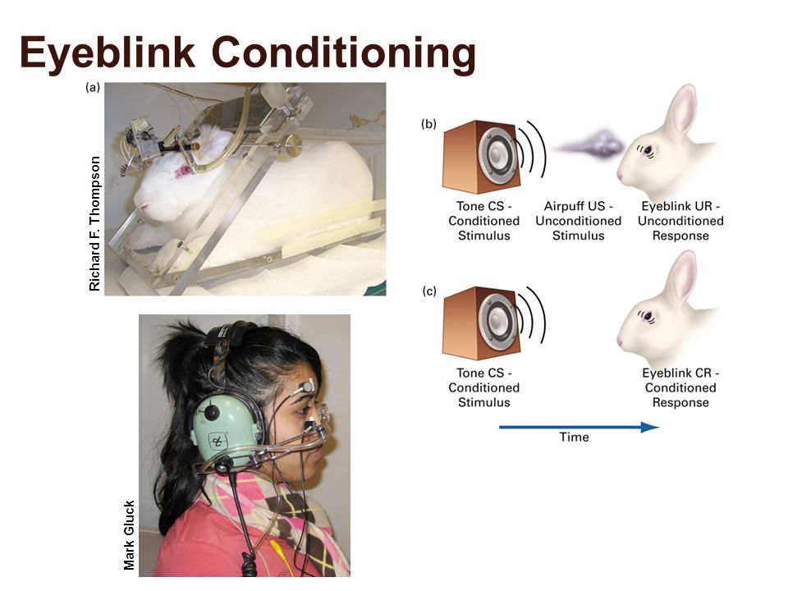
Rescorla-Wagner (1972)
Empirical (data-driven) model of conditioning
Main scope of explanation – reflexive behaviours
Theoretical goal – to assimilate important empirical phenomena

Slide 4

1. Kamin blocking
Phase 1: Association with A
Decreased association.
Dependent on strength of association with A.
Phase 2: Association with AX
Phase 2: Test Association with X alone

Slide 5
When blocking doesn’t work
Low number of trials of A (tone)
Extinction of association with A
Tone played alone without air puff
Reduction in intensity of A during training of compound AX
A in AX < A alone
Nature of US
Air puff vs shock, or shocks of different size

Slide 6
2. Overshadowing
Phase 1: Strong A + Weak X
Decreased association.
Phase 2: Test Association with X alone

Slide 7
Rescorla-Wagner Theory Intuitions
Change in associative strength for a CS-US pair depends on:
1) Maximum possible associative strength
2) Salience of the CS
3) Learning rate – specific to the US

Slide 8
Rescorla-Wagner Theory Intuitions
Change in associative strength for a CS-US pair depends on:
1) Maximum possible associative strength
2) Salience of the CS
3) Learning rate – specific to the US

Slide 9
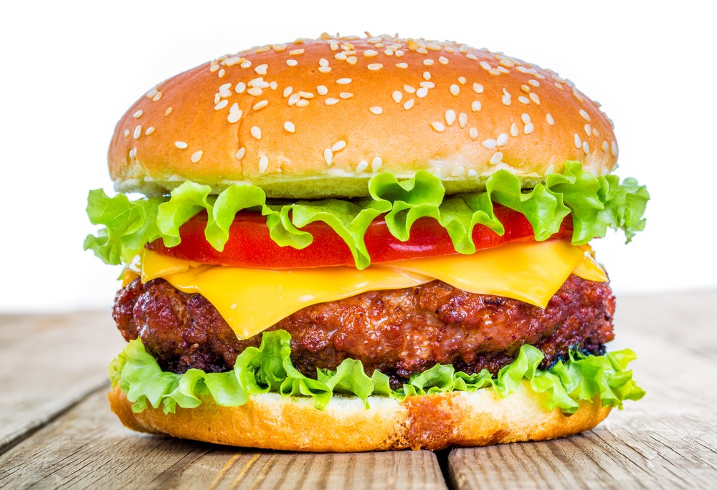
Very fast learning
Food poisoning
Taste aversion

Slide 10
In contrast to…..
Eye puff reflex
Fear conditioning
Withdrawl reflex
Most trial-by-trial learning

Slide 11
Rescorla-Wagner Theory Intuitions
Change in associative strength for a CS-US pair depends on:
1) Maximum possible associative strength
2) Salience of the CS
3) Learning rate – specific to the US

Slide 12
Influence of salience
More taste aversion for…
Bread?
Lettuce?
Tomato?
Cheese?
Meat?
Meat > cheese > bread …..
Order of salience

Slide 13
Rescorla-Wagner Theory Intuitions
Change in associative strength for a CS-US pair depends on:
1) Maximum possible associative strength
2) Salience of the CS
3) Learning rate – specific to the US

Slide 14
Maximum associative strength
Nausea from taste aversion less extreme than food poisoning
CR < UR
Same for eye-blink and other reflexes
Varies for different UR

Slide 15

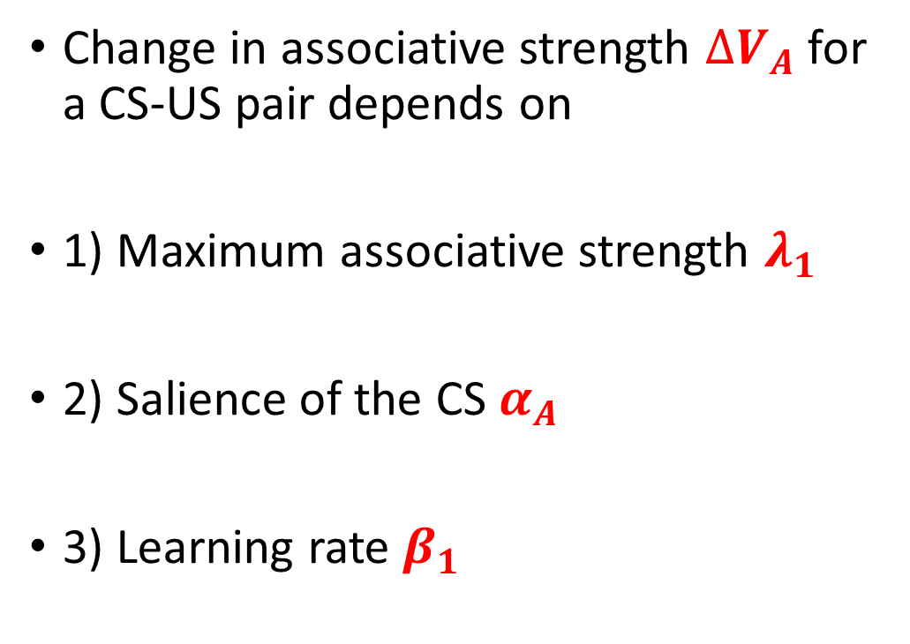
Rescorla-Wagner Theory Intuitions
Change in associative strength $∆V_{A}$ for a CS-US pair depends on
1) Maximum associative strength $λ_{1}$
2) Salience of the CS $α_{A}$
3) Learning rate $β_{1}$
Simple equation
$$∆V_{A}=α_{A}β_{1}\left(λ_{1}−V_{A}\right)$$

Slide 16
Interpreting Associative Strength
Not behaviourism – not just probability of behavior
Cognitive interpretation – connection in mind between two stimuli

Slide 17

Rescorla-Wagner Theory Formalisation
Change in associative strength $∆V_{A}$ for a CS-US pair depends on
1) Maximum associative strength $λ_{1}$
2) Salience of the CS $α_{A}$
3) Learning rate $β_{1}$
Simple equation
$$∆V_{A}=α_{A}β_{1}\left(λ_{1}−V_{A}\right)$$
Prediction error
Psychological: surprise
Kamin interpretation

Slide 18

Compound conditioned stimulus
Meat, cheese, etc
Light, sound, etc
$V_{A},V_{X}$, etc

Slide 19

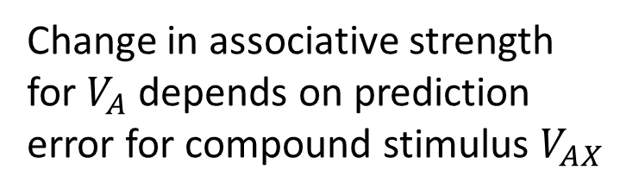
Rescorla-Wagner Theory Formalisation
Change in associative strength $∆V_{A}$ for a CS-US pair depends on
1) Maximum associative strength $λ_{1}$
2) Salience of the CS $α_{A}$
3) Learning rate $β_{1}$
$$∆V_{A}=α_{A}β_{1}\left(λ_{1}−V_{AX}\right)$$
Change in associative strength for $V_{A}$ depends on prediction error for compound stimulus $V_{AX}$

Slide 20


Rescorla-Wagner Theory Formalisation
Change in associative strength $∆V_{A}$ for a CS-US pair depends on
1) Maximum associative strength $λ_{1}$
2) Salience of the CS $α_{A}$
3) Learning rate $β_{1}$
$$∆V_{A}=α_{A}β_{1}\left(λ_{1}−V_{AX}\right)$$
$$∆V_{X}=α_{X}β_{1}\left(λ_{1}−V_{AX}\right)$$
$$V_{AX}=V_{A}+V_{X}$$

Slide 21
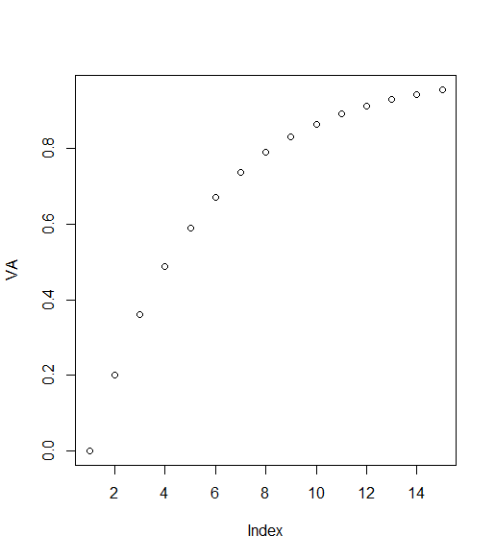
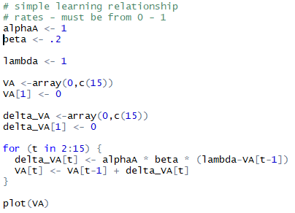
Rescorla-Wagner Simulation (try at home)

Slide 22

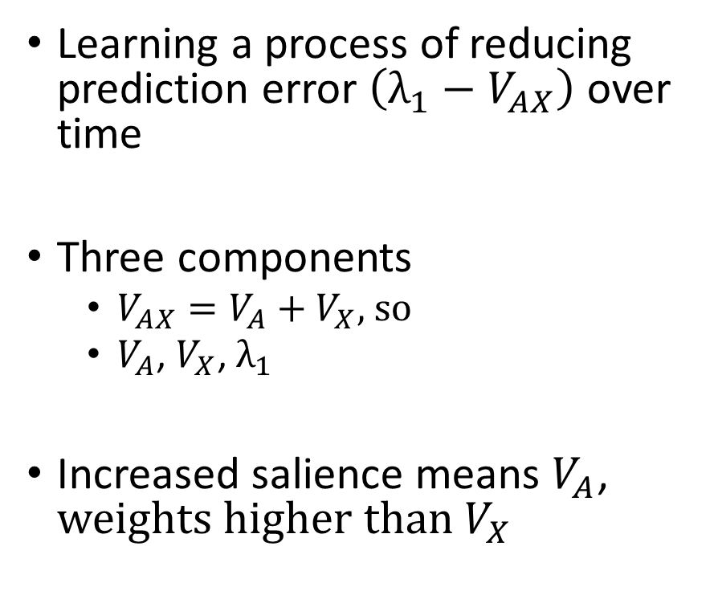


Explaining Overshadowing
Learning a process of reducing prediction error $\left(λ_{1}−V_{AX}\right)$ over time
Three components
$V_{AX}=V_{A}+V_{X}$, so
$V_{A}$, $V_{X}$, $λ_{1}$
Increased salience means $V_{A}$, $weights higher than V_{X}$
$$1. ∆V_{A}=α_{A}β_{1}\left(λ_{1}−V_{AX}\right)$$
$$2. ∆V_{X}=α_{X}β_{1}\left(λ_{1}−V_{AX}\right)$$
$${3.V}_{AX}=V_{A}+V_{X}$$

Slide 23
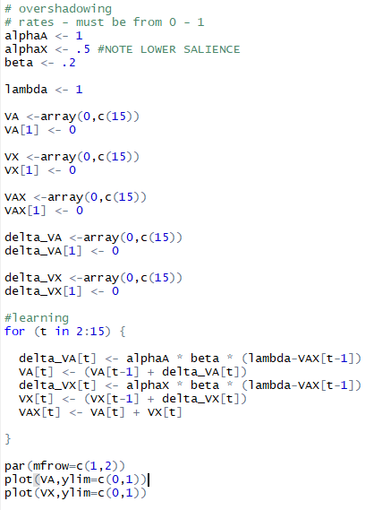
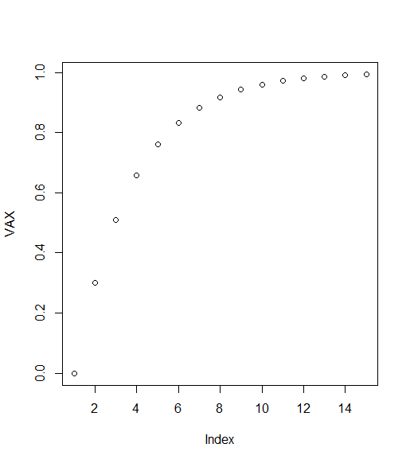
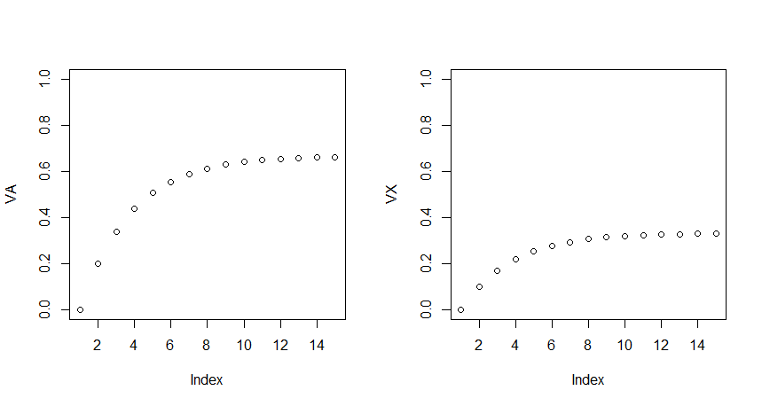
Lower associative strength
Decompose

Slide 24
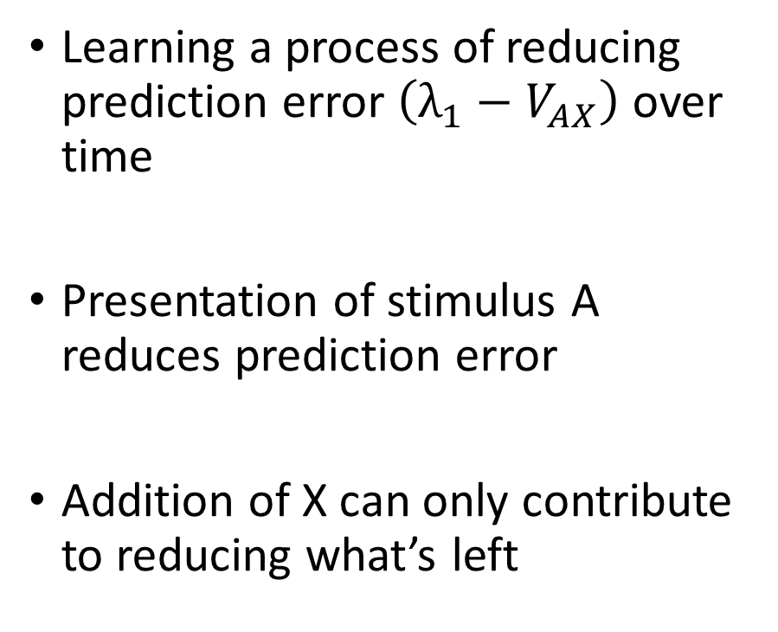
Explaining Blocking
Learning a process of reducing prediction error $\left(λ_{1}−V_{AX}\right)$ over time
Presentation of stimulus A reduces prediction error
Addition of X can only contribute to reducing what’s left
$$1. ∆V_{A}=α_{A}β_{1}\left(λ_{1}−V_{AX}\right)$$
$$2. ∆V_{X}=α_{X}β_{1}\left(λ_{1}−V_{AX}\right)$$
$${3.V}_{AX}=V_{A}+V_{X}$$

Slide 25
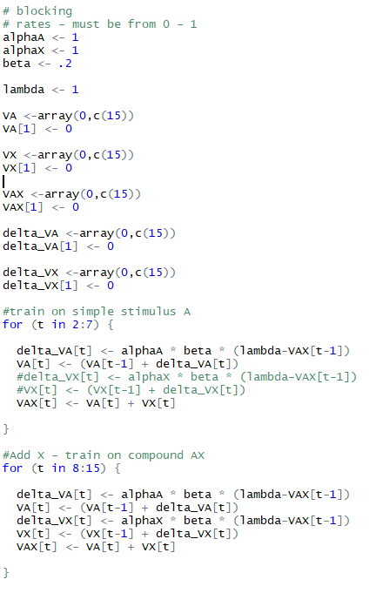
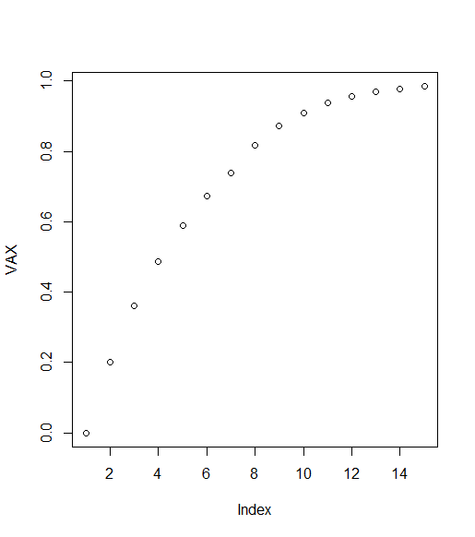
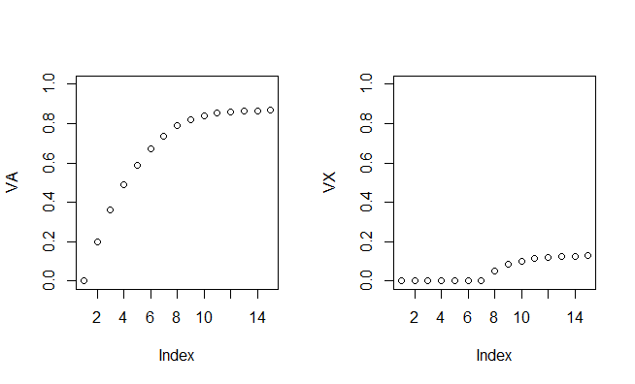
Decompose
Phase 1 – 7 trials
Phase 2 – 8 trials

Slide 26
Modern usefulness of Rescorla-Wagner
(Imperfect) model of conditioning
(Foundations of) model for updating expected value
(Foundations of) Model for updating weights in neural networks

Slide 27



Modern learning rules
Rescorla-Wagner
$$1. ∆V_{A}=α_{A}β_{1}\left(λ_{1}−V_{AX}\right)$$
$$2. ∆V_{X}=α_{X}β_{1}\left(λ_{1}−V_{AX}\right)$$
$${3.V}_{AX}=V_{A}+V_{X}$$
Delta rule
$${EV}_{t}={EV}_{t−1}+β\left(V_{t−1}−{EV}_{t−1}\right)$$
OR
$${EV}_{t}={\left(1−β\right)EV}_{t−1}+β\left(V_{t−1}−{EV}_{t−1}\right)$$

Slide 28
Theoretical interpretation of V
Not a probability of a behaviour
Associative strength between two mental elements
(Later) model of expected value of choice
How do we move from associative strength to behavior?

Slide 29
Luce’s Choice Axiom

Slide 30
Disclaimer I will try to be clear and accurate but I am not a mathematician or logician

Slide 31
Luce’s choice axiom
Rescorla-Wagner model
Empirically driven theory of behavior
Goal to explain well-known empirical effects
Formalisation oriented towards capturing patterns in data
Luce’s choice model
Logically derived model of behavior
Formalisation grounded in First Principles
Axiom – Something we assume without proof
Theoretically stated hypothesis

Slide 32
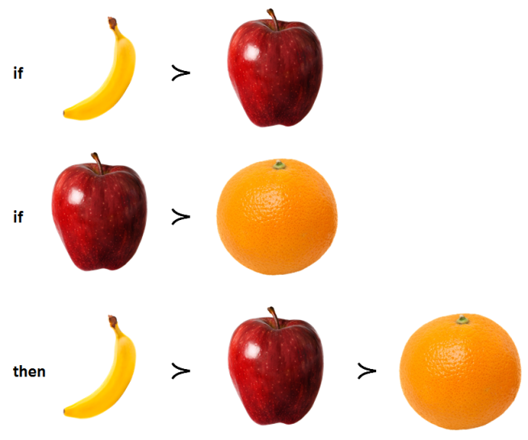
First tenet – choice is probablistic
Classical economic models
Choice is determined by things like preferences and beliefs
… according to rules or axioms (e.g. transitivity)
(Incidentally) these are commonly violated
Luce – mathematical psychology
Preferences influence the probability of choices
Choice is probabilistic, build from within probability theory

Slide 33
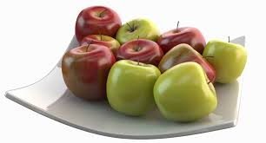
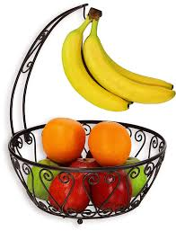
Second tenet – nesting
The probability of choosing (e.g. a red or green apple) from a smaller set of options (e.g. apples)….
……is related to the probability of choosing that same thing from a larger set (a bowl of fruit with apples of different colors)…..
…. formalised in set and probability notation

Slide 34
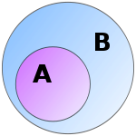
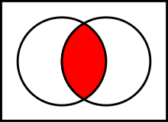
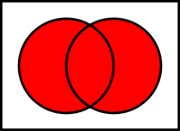
Set and probability notation
{} - Set
⊂ - Strict subset
∩ - Intersection (or)
⋃ - Union (and)
∈ - Element/member of
P_{A} (X) - Probability of X in set A
P(X,Y) – Joint probability of X and Y in set A
A={1,3,5,7,9}; B={1,2,3,4,5}
{1,3,5,7} ⊂ {1,3,5,7,9}
A∩B – {1,3,5}
A⋃B - {1,2,3,4,5,7,9}
9∈A
P_{A}(9) = 0.2
P_{A}(7,9) = P_{A}(7) * P_{A}(9) = 0.04

Slide 35
Axioms of Probability (in context of choice)
For S ⊂ T, 0 ≤ P_{T} (S) ≤ 1
For any strict subset S of set of options T, the probability of something being chosen from within S must be from zero to one (included)
(Probability of an event is a non-negative real number)
P_{T} (T) = 1
The probability of the set of possible events (available choices) is 1
(From the nominal definition of certainty)
If R,S ⊂ T and R∩S = 0, then P_{T} (R ⋃ S) = P_{T} (R) + P_{T} (S)
If R and S are non-intersecting subsets of T, then the probability of their union is the sum of their individual probabilities
E.g. The probability of choosing an apple (R) or a banana (S) from available fruits (T) = p(apple) + p(banana)
T
S
R

Slide 36
Choice Axiom
The question you should be thinking of to understand why the choice axiom matters…..
….is how choice probability can be influenced by the context options are presented in….
….where context is limited to the other options presented (not social stuff)
E.g. what do the different bowls mean for the probability of choosing of a red apple?

Slide 37
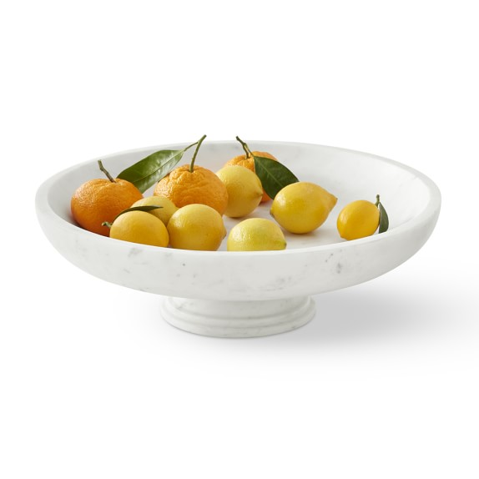
Choice Axiom – Getting Started
If P(X,Y) ≠ 0,1…..
If X and Y are not jointly impossible (or jointly certain)….
…before we can talk about the probability of choosing a red or a green apple, there have to actually be some red and green apples in the bowl!
(Part 2 of the axiom handles this with deletion and will be ignored)

Slide 38
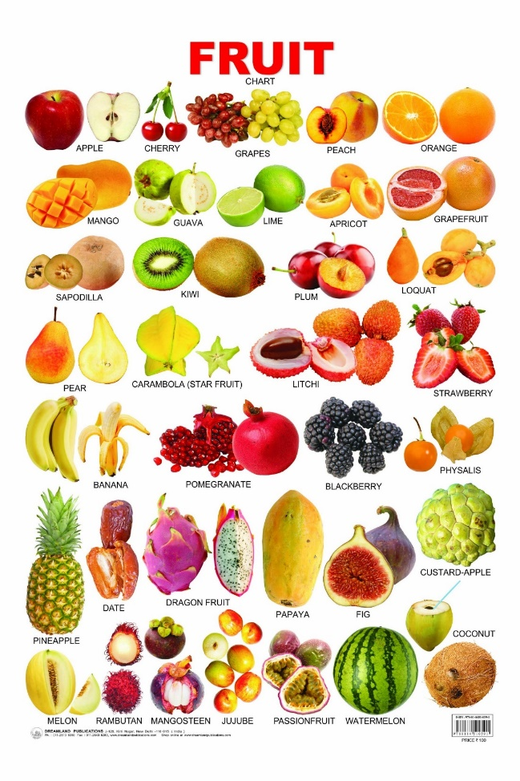
Defining our sets – let’s choose a red apple!
Set R
Set S
Set T

Slide 39
If P(X,Y) ≠ 0,1 for all x, y ∈ T, then for
R⊂S⊂T,
P_{T}(R) = P_{S}(R)*P_{T}(S)
When R is a subset of S, which is a subset of T….
….the probability of choosing an option from the subset R of T, is equal to the probability of choosing the option from the subset R of S, times the probability of choosing the option from the subset S of T
For example
P_{T}(R) - The probability of choosing a red or green apple from all possible fruits (i.e. the big set T), is equal to
P_{S}(R) – The probability of choosing a red or green apple from the bottom bowl (i.e. the middle set S), times
P_{T}(S) – The probability of choosing one of the fruits appearing in the bottom bowl, from any possible fruit

Slide 40

Why does this matter!
It will (soon) allow us to define the probability of choosing an option within a set….
…. in terms of a weighting function…..
….which we can understand in terms of utility….
…which we can then update using Rescorla-Wagner

Slide 41
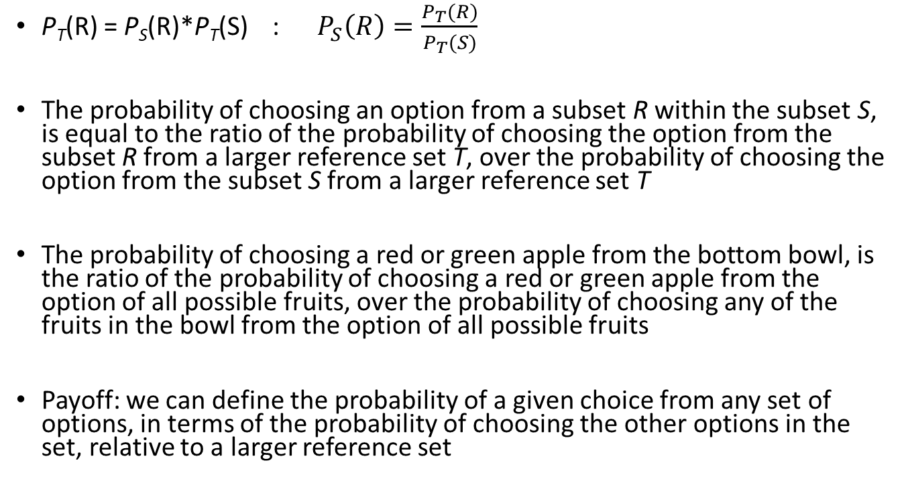
Let’s re-arrange the equation….
P_{T}(R) = P_{S}(R)*P_{T}(S) : $P_{S}\left(R\right)=\frac{P_{T}(R)}{P_{T}(S)}$
The probability of choosing an option from a subset R within the subset S, is equal to the ratio of the probability of choosing the option from the subset R from a larger reference set T, over the probability of choosing the option from the subset S from a larger reference set T
The probability of choosing a red or green apple from the bottom bowl, is the ratio of the probability of choosing a red or green apple from the option of all possible fruits, over the probability of choosing any of the fruits in the bowl from the option of all possible fruits
Payoff: we can define the probability of a given choice from any set of options, in terms of the probability of choosing the other options in the set, relative to a larger reference set

Slide 42
Graphical simplification – “using up” or allocating available probability
P(choice from fruit bowl, from set of all fruits)

Slide 43
Graphical simplification – “using up” or allocating available probability
P(choice from fruit bowl, from set of all fruits)
P(red apple, from the fruitbowl)

Slide 44
Graphical simplification – “using up” or allocating available probability
P(choice from fruit bowl, from set of all fruits)
P(red apple, from the fruitbowl)
P(green apple, from the fruitbowl)

Slide 45
Graphical simplification – “using up” or allocating available probability
P(choice from fruit bowl, from set of all fruits)
P(red apple, from the fruitbowl)
P(green apple, from the fruitbowl)
P(yellow apple, from the fruitbowl)
Standardise probability of choice to reference set

Slide 46
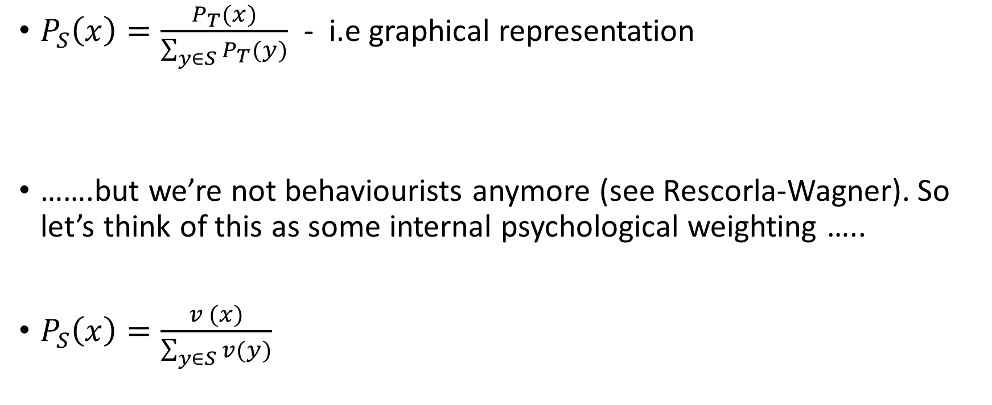
Generalising the formalism
$P_{S}\left(x\right)=\frac{P_{T}(x)}{\sum_{y∈S}{P_{T}(y)}}$ - i.e graphical representation
…….but we’re not behaviourists anymore (see Rescorla-Wagner). So let’s think of this as some internal psychological weighting …..
$P_{S}\left(x\right)=\frac{v (x)}{\sum_{y∈S}{v(y)}}$

Slide 47
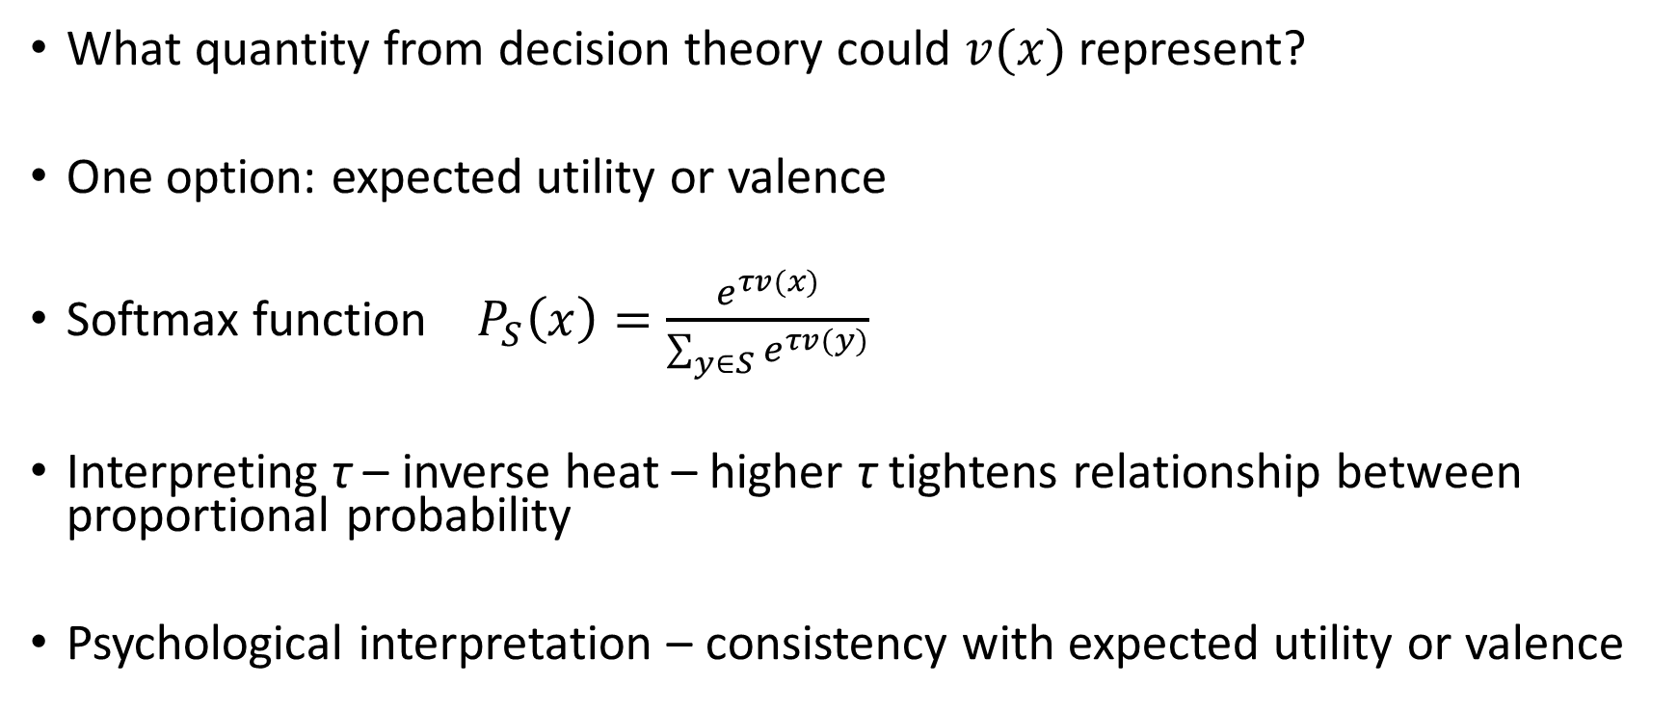

Interpreting $v(x)$ – value in softmax
What quantity from decision theory could $v(x)$ represent?
One option: expected utility or valence
Softmax function $P_{S}\left(x\right)=\frac{e^{τv(x)}}{\sum_{y∈S}{e^{τv(y)}}}$
Interpreting τ – inverse heat – higher τ tightens relationship between proportional probability
Psychological interpretation – consistency with expected utility or valence

Slide 48
Modern Usefulness of Softmax/Choice Axiom
Multinomial regression
Machine learning generally
Transform any weighting or value to probability

Slide 49
Today’s goals – constructing real models
Two modeling approaches
Empirical – data driven
Axiomatic – logic driven
Two psychological processes
Learning
Choice
A framework for modeling decision making
Bandit Models
Broader relevance of models
Machine learning & Neural networks

Slide 50
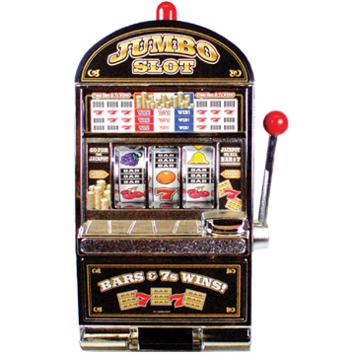

n-armed bandits
Slot-machine: one armed bandit
Probability of win x for each lever pull
Imagine different slot machines have different values and payoff rates
Task: learn which machine to play

Slide 51
Psychological processes
Value based re-inforcement learning
Choice
Exploration and exploitation
Delta rule + softmax
Let’s build a model (model 3, Wilson & Collins)

Slide 52
Plate notation
What’s missing?
Q^{k}_{t}
Expected utility of option k, on trial t
p^{k}_{t}
Probability of choosing option k, on trial t
k options
k_{t}
Choice on trial t (from options 1 to k)
t trials

Slide 53
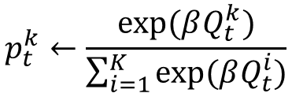

Plate notation- Luce choice
Q^{k}_{t}
Expected utility of option k, on trial t
β
p^{k}_{t}
$$p_{t}^{k}←\frac{exp⁡(βQ_{t}^{k})}{\sum_{i=1}^{K}{exp⁡(βQ_{t}^{i})}}$$
Probability of choosing option k, on trial t
k options
k_{t}
Choice on trial t (from options 1 to k)
$$k_{t}\sim Categorical(p_{t})$$
t trials

Slide 54
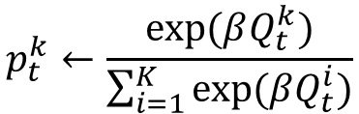

Plate notation- Delta rule
Q^{k}_{t-1}
a
Q^{k}_{t}
r_{t-1}
$$Q_{t}^{k}←Q_{t−1}^{k}+a(r−Q_{t−1}^{k})$$
β
p^{k}_{t}
$$p_{t}^{k}←\frac{exp⁡(βQ_{t}^{k})}{\sum_{i=1}^{K}{exp⁡(βQ_{t}^{i})}}$$
k options
k_{t}
$$k_{t}\sim Categorical(p_{t})$$
t trials

Slide 55
Bandit model
Q^{k}_{t-1}
a
Q^{k}_{t}
r_{t-1}
$$Q_{t}^{k}←Q_{t−1}^{k}+a(r−Q_{t−1}^{k})$$
β
p^{k}_{t}
$$p_{t}^{k}←\frac{exp⁡(βQ_{t}^{k})}{\sum_{i=1}^{K}{exp⁡(βQ_{t}^{i})}}$$
k options
k_{t}
$$k_{t}\sim Categorical(p_{t})$$
t trials

Slide 56
Today’s goals – constructing real models
Two modeling approaches
Empirical – data driven
Axiomatic – logic driven
Two psychological processes
Learning
Choice
A framework for modeling decision making
Bandit Models
Broader relevance of models
Machine learning & Neural networks

Slide 57
The importance of Q-learning
Basis of “model free” reinforcement learning in computational neuroscience and machine learning
Algorithm for learning optimal policy from reinforcement
Employed in neural network architectures, including deep learning
Employed in developmental robotics, and for building adaptive robots

